Slide 1
7. Multi Agent Systems
JADE
(Laboratory Session)
Ignasi Gómez-Sebastià
SID 2014

Slide 2
Agent Platform
Start Agent Platform (Running jade.txt)
  GUI
  Dummy Agent
  Sniffer
  Introspector

Slide 3
Hello World Agent
Imports
Extends Agent
AID
Arguments
Modify and run your own agent
  Via GUI
  Via console
  Check results on GUI
  Use sniffer on agent

Slide 4
Behaviours
One shot and Waker
Cyclic and ticker
  Action (OnTick / OnWake)
  OnStart
  OnEnd
  Done
  Setup
  doDelete
  takeDown
Run the 4 agents and check their behaviour
Notes:
Waker is a chinese brand alarm clock
Cyclic will perform tasks over and over again, ticker will wait some time between executions
Waker will wait some time, execute task and stop
doDelete : Transition on agent state to deleted
Done checks if the behaviour is done
takeDown: Agent cleaning code. Executed when agent dies (e.g., release files or DB access)

Slide 5
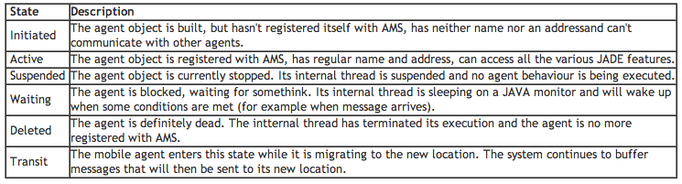
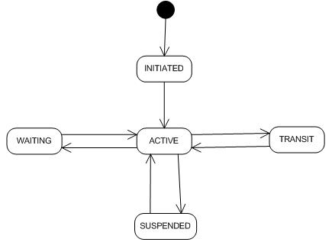
Agent life-cycle

Slide 6
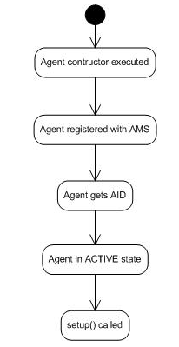
Agent life-cycle
addBehaviour
removeBehaviour
blockingReceive
Notes:
Several parallel behaviours cooperating on a single Java thread. Non preemptive, will only change behaviour once the actual behaviour meets done condition!!
An agent registers several behaviours. One from the pool of active behaviours is selected (non-blocked behaviours) Which one, non-deterministic, if you want to control it, remove undesired behaviours from the pool by blocking them or code a behaviour selection procedure (advanced feature).
What happens if the pool of active behaviours is empty? Agent is suspended.

Slide 7
Message passing I
Lover agent
  Blocking a behaviour until agent from beloved one arrives
  What is the state of the agent?
  Is it a good idea to block outside the behaviour?
  Receive message using a template
  Send message using a performative
Run lover agents and check their behaviour
  GUI
  Console (Sniffer)
Notes:
Waker is a chinese brand alarm clock
Cyclic will perform tasks over and over again, ticker will wait some time between executions
Waker will wait some time, execute task and stop
doDelete : Transition on agent state to deleted
Done checks if the behaviour is done
takeDown: Agent cleaning code. Executed when agent dies (e.g., release files or DB access)

Slide 8
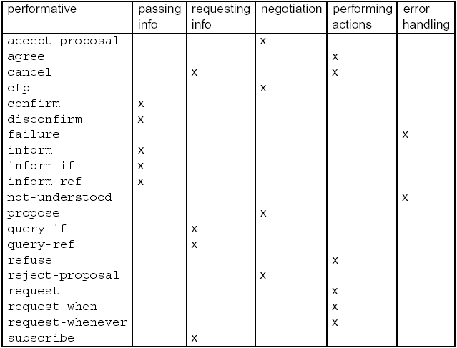
Message passing II
Notes:
Waker is a chinese brand alarm clock
Cyclic will perform tasks over and over again, ticker will wait some time between executions
Waker will wait some time, execute task and stop
doDelete : Transition on agent state to deleted
Done checks if the behaviour is done
takeDown: Agent cleaning code. Executed when agent dies (e.g., release files or DB access)

Slide 9
Message passing III
DF Agent
  Register
  Modify
  De-register
  Search
Run lover agents and check their behaviour
  GUI
  Console (Sniffer)
Notes:
DF Stands for?

Slide 10
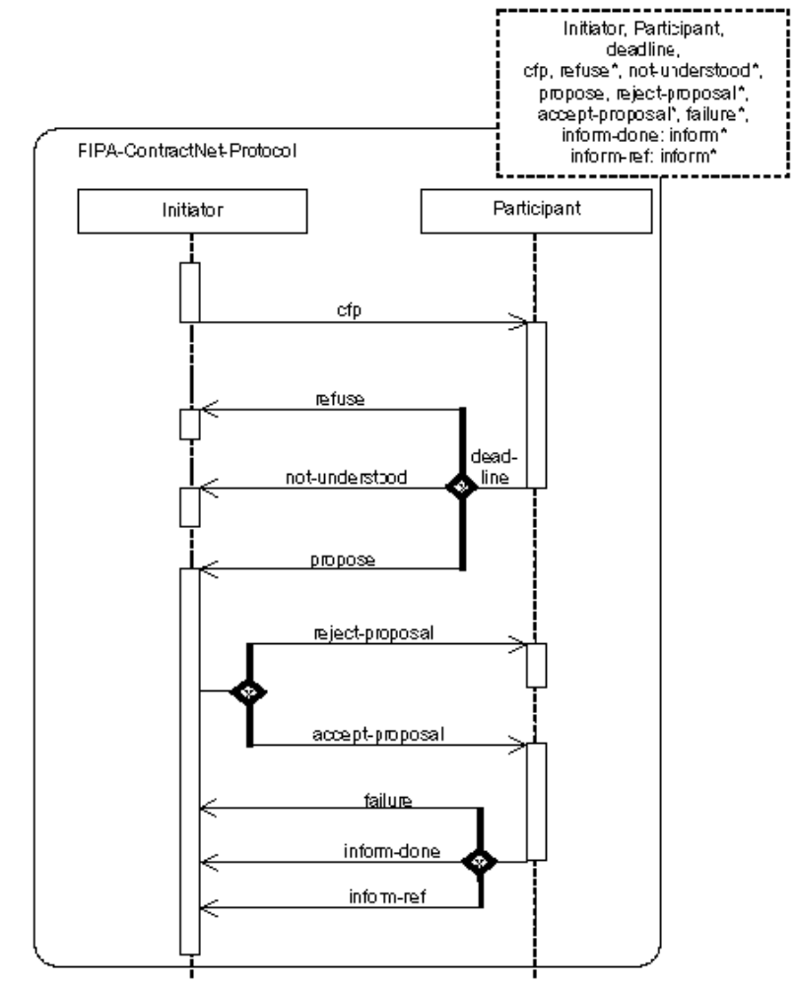
FIPA Contract-Net protocol
ContractNetInitiatorAgent
ContractNetResponderAgent
Run agents
  Console
  GUI sniffing
  GUI introspector
Notes:
Where is the decission taking mechanism?
Where is the action mechanisim?

